Slide 1
EEG-based Reading Skill Evaluation Model Design
Biomedical Engineering Capstone Design I
Final Presentation
CoNE Lab. – 임창환 교수님
2017030828 Jihyeok Kim
2022.06.20.

Slide 2


Contents
Introduction
Research Background
Related Works
Research Overview
Methods
Data Acquisition
Data preprocessing
Model test
Result
Model I
Model II
Model III
Conclusion & Discussion
References
Hanyang University Biomedical Engineering
Computational Neuroengineering Laboratory

Slide 3
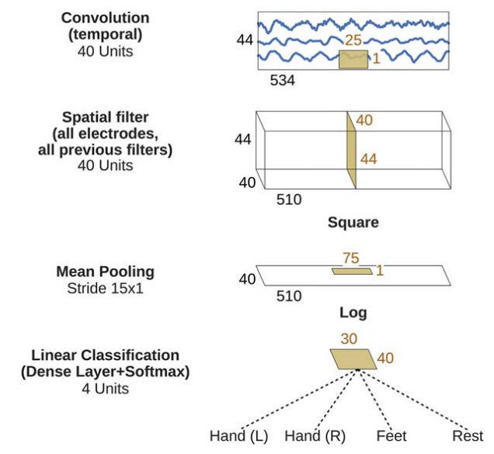
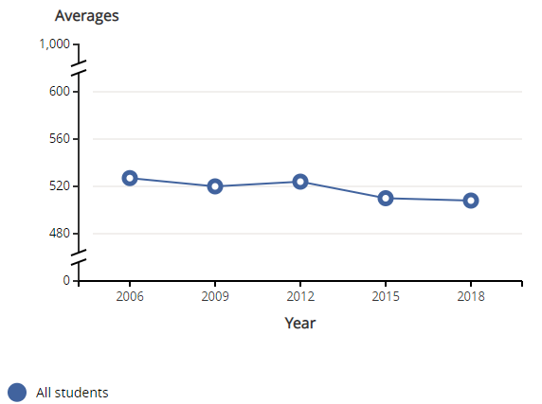
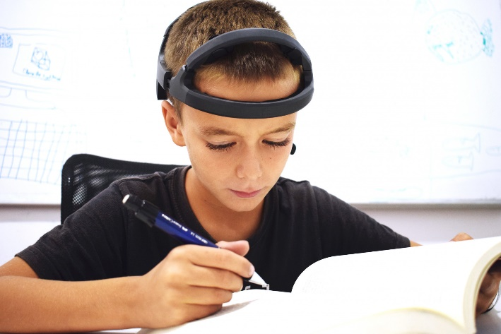
I. Introduction
1. Research Background
Specialized Convolutional Neural Networks (CNN) Model for EEG features Extraction: Braindecode
Korea’s reading score graph of OECD's Programme for International Student Assessment (PISA)
Development of Neuro-imaging Technology, and Increasing Interest on Neuro-education
Source:
https://pisadataexplorer.oecd.org/ide/idepisa/
https://www.bitbrain.com/blog/eeg-test
Hanyang University Biomedical Engineering
Computational Neuroengineering Laboratory

Slide 4
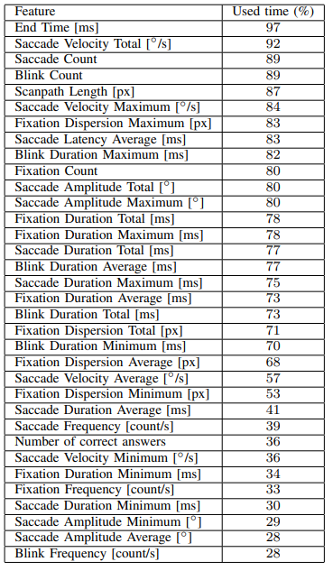
I. Introduction
2. Related Works
Augereau, et al. “Towards an Automated Estimation of English Skill via TOEIC Score Based on Reading Analysis”
TOEIC Score Prediction
Eye Tracker
+
Machine Learning
→
So, et al. “An Evaluation of Mental Workload with Frontal EEG”
Frontal EEG
Machine Learning
Mental Workload Prediction
+
→
Ahn, et al. “Towards Predicting Reading Comprehension From Gaze Behavior”
Reading Skill Prediction
[Fig. List of extracted features in the first paper]
Eye Tracker
+
CNN, RNN*
→
*Recurrent Neural Network
Hanyang University Biomedical Engineering
Computational Neuroengineering Laboratory

Slide 5
I. Introduction
3. Research Overview
Feedback
Data Acquisition
Preprocessing
Modeling
Model Test
Acquired from experiment
Segmentation
Filtering
Down-sampling
2s window with 50 % overlapping
EEG-based model variations
Leave-one-subject-out validation
Accuracy, F1-score
Hanyang University Biomedical Engineering
Computational Neuroengineering Laboratory

Slide 6
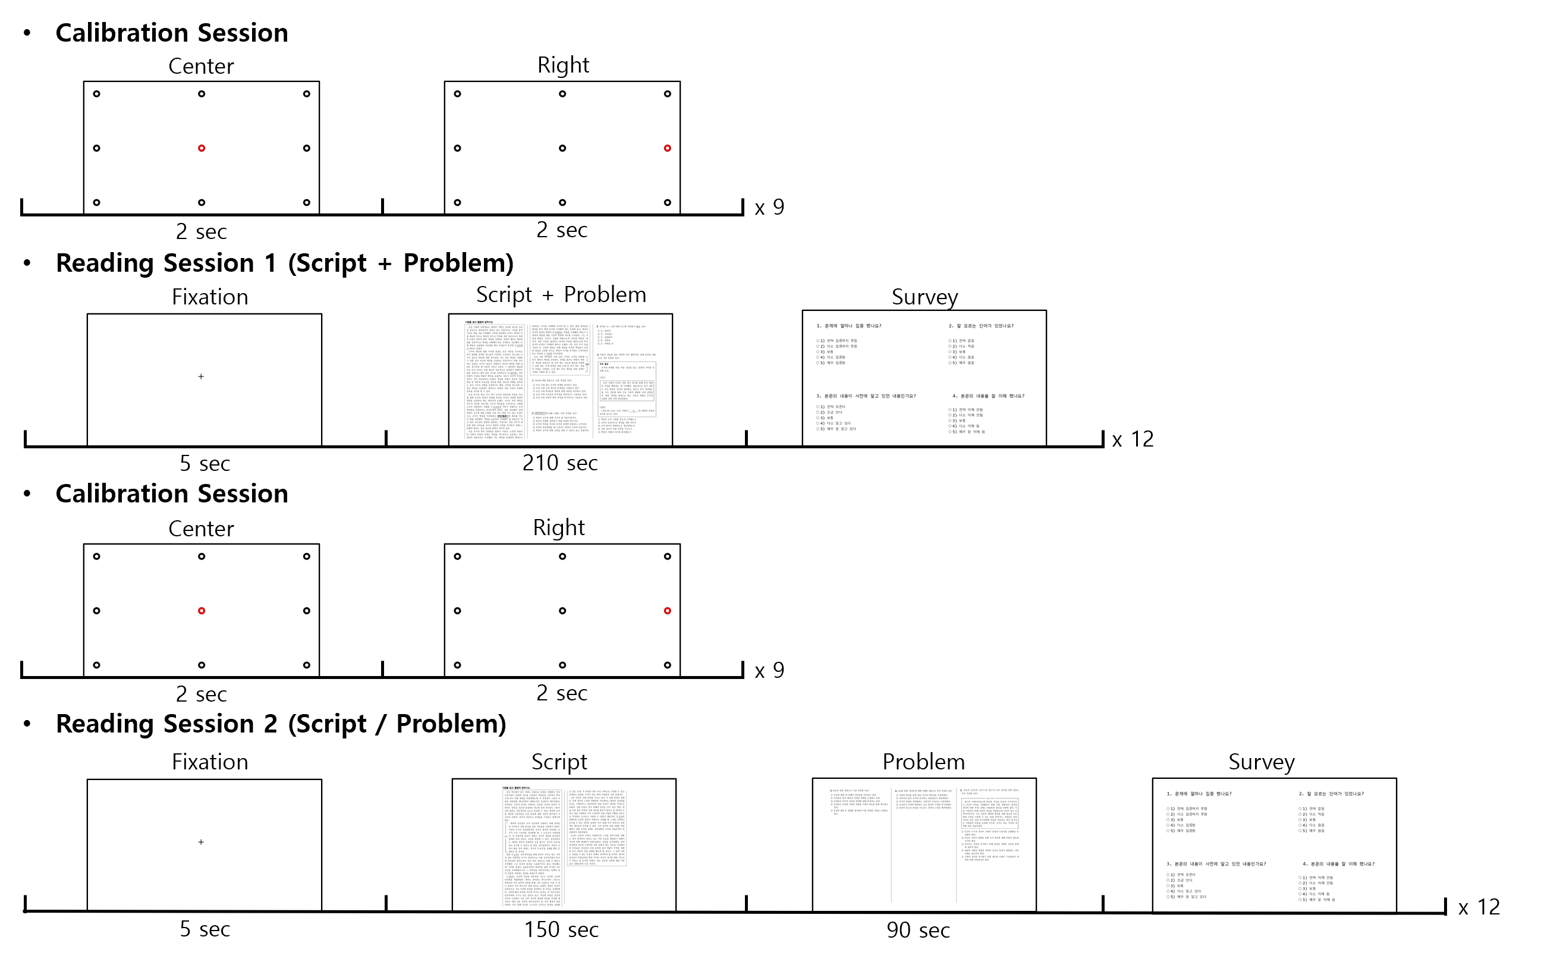
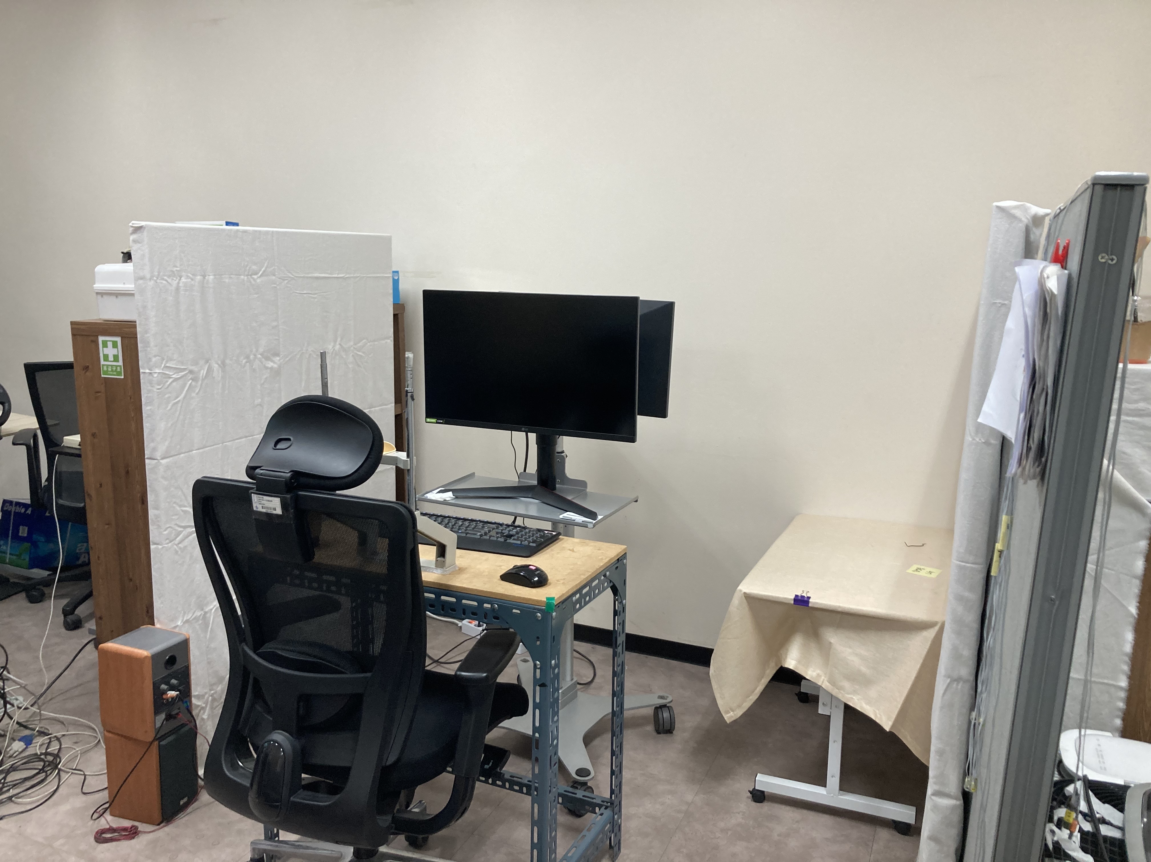
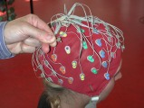
II. Methods
1. Data Acquisition
Experiment paradigm
20 subjects (10 female, average age: 22.7)
2048 Hz sampling rate with Biosemi
37 channels (32 EEG + 5 EOG) used
3 problems per script, 10 scripts per session, 2 sessions per subject
EEG, EOG, and Score data acquired
X 10
X 10
Hanyang University Biomedical Engineering
Computational Neuroengineering Laboratory
Source: https://www.biosemi.com/faq/skin_preparation.htm

Slide 7
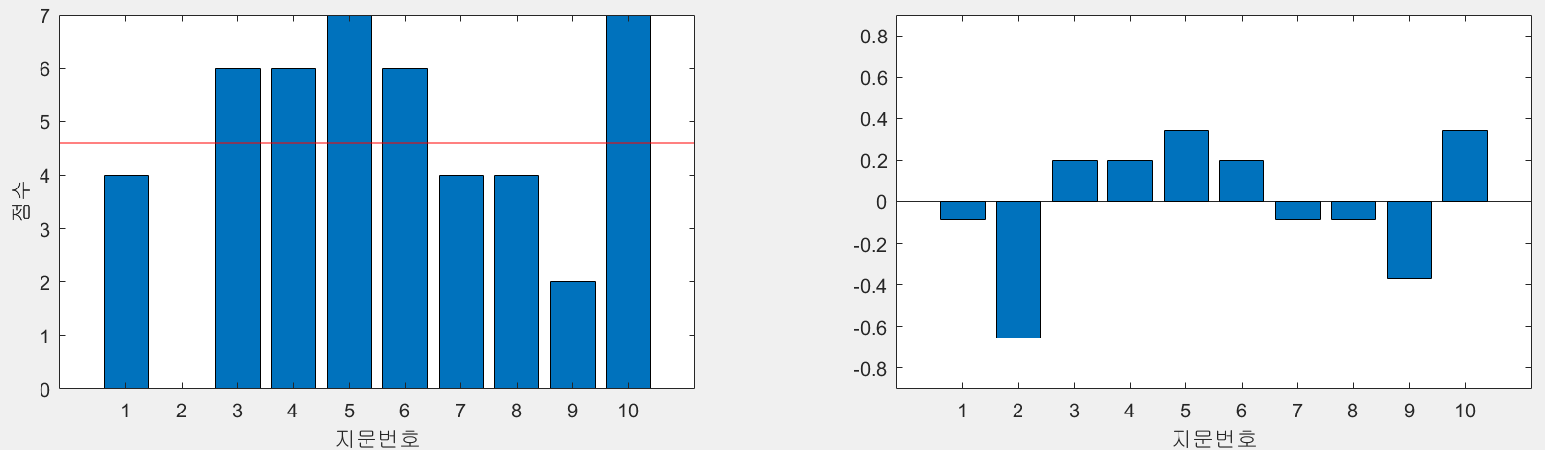
II. Methods
2. Data Preprocessing
EEG and EOG data
Trigger Segmentation
Bandpass Filtering (4th Butterworth filter) : 0.1 Hz ~ 55 Hz
Down sampling : 2048 Hz > 256 Hz (EEG)
2s window with 50 % overlapping
Score data (Target Label)
Normalization
Score
Normalized Score*
Script No.
*Normalized Score (Deviation):
Score / 7 – mean(sum(Score/7))
1s
Data
…
2s
Hanyang University Biomedical Engineering
Computational Neuroengineering Laboratory

Slide 8
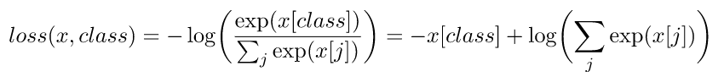
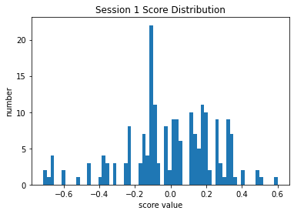
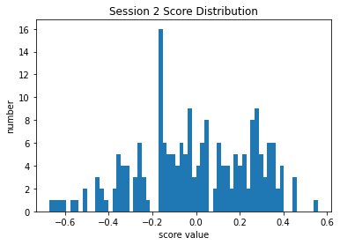
II. Methods
3. Model test: regression problem -> two class classification problem
bad: score error < 0
good: score error > 0
Loss: Cross Entropy Loss
Score Distribution check
score 분포 | Session 1 | Session 2
bad | 95 | 99
good | 105 | 101
total | 200 | 200
Hanyang University Biomedical Engineering
Computational Neuroengineering Laboratory

Slide 9

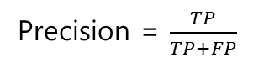
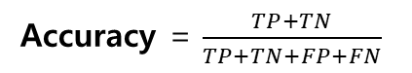
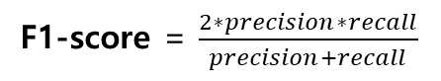
II. Methods
3. Model test
Leave-One-Out Cross Validation
Subject 1
Subject 2
Subject 3
…
Subject 15
Subject 16
…
Subject 19
Subject 20
15 training set
4 validation set
1 test set
Metric
Accuracy = $\frac{TP+TN}{TP+TN+FP+FN}$
Precision = $\frac{TP}{TP+FP}$
Recall = $\frac{TP}{TP+FN}$
F1-score = $\frac{2∗precision∗recall}{precision+recall}$
$TP$: True Positive, $TN$: True Negative, $FP$: False Positive, $FN$: False Negative
Hanyang University Biomedical Engineering
Computational Neuroengineering Laboratory

Slide 10
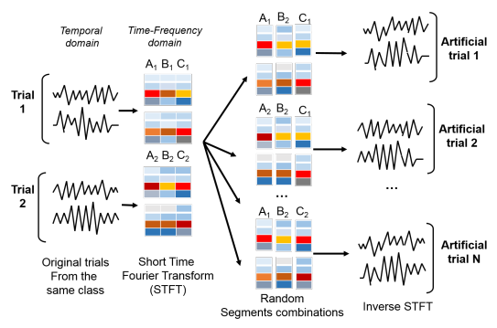
II. Methods
Model I, II, III: CNN + RNN Model
Hyperparameters setting
AdamW (Lr = 0.000625), learning rate scheduler
early stopping with patience 5, 10 epochs warming up
3. Data Augmentation
STFT (Short-Time Fourier Transform) based recombination 방법을 이용하여 데이터 증강
각 채널 별로 time-frequency domain에서 서로 다른 trial의 데이터를 재조합하여 새로운 artificial trial data 생성
Source: F. Lotte et al., "A review of classification algorithms for EEG-based brain–computer interfaces: A 10 year update", J. Neural Eng., vol. 15, no. 3, 2018.
Hanyang University Biomedical Engineering
Computational Neuroengineering Laboratory

Slide 11
III. Result
1. Model I
Leave-One-Out Cross Validation Result
Model | Accuracy | F1-score
Model I without data augmentation | 0.4700 | 0.4110
32
Convolution (temporal)
512
GRU
Linear
Softmax
32
40
486
Model | Accuracy | F1-score
Model I with data augmentation | 0.4767 | 0.1503
Convolution (Spatial)
+ Square
40
2
2
486
1
1
Mean Pooling
55
1
40
Convolution
40
400
length
20
20
Hanyang University Biomedical Engineering
Computational Neuroengineering Laboratory

Slide 12
III. Result
1. Model II
Leave-One-Out Cross Validation Result
Model | Accuracy | F1-score
Model II without data augmentation | 0.6800 | 0.6577
32
Convolution (temporal)
512
GRU
Linear
Softmax
32
40
486
Max
Pooling
Model | Accuracy | F1-score
Model II with data augmentation | 0.7017 | 0.6905
Convolution (Spatial)
+ Square
40
2
2
486
1
1
Mean Pooling
55
1
40
Convolution
40
400
length
20
20
Hanyang University Biomedical Engineering
Computational Neuroengineering Laboratory

Slide 13
III. Result
1. Model III
Leave-One-Out Cross Validation Result
Model | Accuracy | F1-score
Model III without data augmentation | 0.6900 | 0.6796
32
Convolution (temporal)
512
GRU
Linear
Softmax
Raw data
32
32
512
Model | Accuracy | F1-score
Model III with data augmentation | 0.6500 | 0.6353
Convolution (Spatial)
+ Square
512
32
Mean Pooling
512
2
2
Max
Pooling
1
1
55
32
1
Convolution
40
40
40
486
400
length
40
20
486
20
Hanyang University Biomedical Engineering
Computational Neuroengineering Laboratory

Slide 14
III. Result
1. Leave-One-Out Cross Validation Result
 | without data augmentation |  | with data augmentation
Model | Accuracy | F1-score | Accuracy | F1-score
I | 0.4700 | 0.4110 | 0.4767 | 0.1503
II | 0.6800 | 0.6577 | 0.7017 | 0.6905
III | 0.6900 | 0.6796 | 0.6500 | 0.6353
Connection network
Hanyang University Biomedical Engineering
Computational Neuroengineering Laboratory

Slide 15
IV. Conclusion & Discussion
EEG 데이터를 이용하여 복잡한 preprocessing이나 hand crafted feature 없이, 새로운 이용자의 독해 능력을 70% 정확도로 예측해내는데 성공함
CNN layer를 통해 뽑아낸 feature에 raw data 정보를 유지시켜주는 connection network가 딥러닝을 이용한 독해 능력 예측 향상에 큰 도움을 줄 수 있음
더 다양한 피험자 데이터를 이용한 데이터 증강 혹은 STFT based recombination 시 한 피험자가 아닌 다양한 피험자 사이의 데이터를 통해 조합하면 성능이 더 향상될 것으로 기대됨
Connection network를 다양한 방법으로 쌓아서 성능 향상을 꾀할 수 있을 것으로 보임
추후 연구에서 EOG 데이터도 함께 이용하는 Multimodal Learning을 시도할 수 있음
Hanyang University Biomedical Engineering
Computational Neuroengineering Laboratory

Slide 16
V. References
[1] 남궁양숙. “OECD 국제 학업성취도 비교 연구(PISA 2018) 결과 발표,” 교육부. 2019.
[2] Ye, et al. “Understanding Human Reading Comprehension with Brain Signals,” arXiv, 2021.
[3] Schirrmeister et al. “Deep Learning With Convolutional Neural Networks for EEG Decoding and Visualization,” Human Brain Mapping, 2017.
[4] Augereau, et al. “Towards an Automated Estimation of English Skill via TOEIC Score Based on Reading Analysis,” 23rd International Conference on Pattern Recognition, 2016.
[5] So, et al. “An evaluation of mental workload with frontal EEG,” PLoS ONE, 2017.
[6] Ahn, et al. “Towards Predicting Reading Comprehension From Gaze Behavior,” ETRA ’20 Short Papers, June 2-5, 2020.
[7] F. Lotte et al., "A review of classification algorithms for EEG-based brain–computer interfaces: A 10 year update", J. Neural Eng., vol. 15, no. 3, 2018.
Hanyang University Biomedical Engineering
Computational Neuroengineering Laboratory

Slide 17
감사합니다
Thank you
Hanyang University Biomedical Engineering
Computational Neuroengineering Laboratory

